Slide 1


Green Pace
Security Policy Presentation
Developer: Tashi Anderson

Slide 2

OVERVIEW: DEFENSE IN DEPTH
This is a security strategy that uses multiple layers of security to continuously protect data. This includes multiple redundancies.

Slide 3
THREATS MATRIX
This defines likely, unlikely, priority, and low priority threats.
Likely STD-004-CPP STD-007-CPP | Priority STD-002-CPP STD-004-CPP STD-008-CPP
Low priority STD-001-CPP STD-003-CPP STD-005-CPP STD-006-CPP STD-010-CPP | Unlikely STD-010-CPP STD-008-CPP STD-006-CPP STD-001-CPP

Slide 4
10 PRINCIPLES
Validate Input Data | Make sure that user inputs are proper, and do not allow unsanitized data.
Heed Compiler Warnings | Compiler warnings serve to remind a developer of potential faults in the code, such as out of date libraries and unused functions.
Architect and Design for Security Policies | Design software to enforce security policies, such as dividing the system into different subsystems with their proper privileges.
Keep It Simple | Don’t create overly complex code, simple systems mean simple errors to fix.
Default Deny | By default, deny access and add permissions when needed.
Adhere to the Principle of Least Privilege | Users should have the least possible privileges set in order to successfully complete their task.
Sanitize Data Sent to Other Systems | Prevent possible SQL injection attacks through proper sanitation.
Practice Defense in Depth | Have multiple defensive strategies deployed in your system, with multiple redundancies.
Use Effective Quality Assurance Techniques | Have multiple and different means of testing your system, such as penetration testing.
Adopt a Secure Coding Standard | Adhere by the coding standards set by your platform and coding language.

Slide 5
CODING STANDARDS
Rule | Severity | Likelihood | Remediation Cost | Priority | Level
STD-001-CPP | Low | Unlikely | Low | P1 | L3
STD-002-CPP | High | Probable | High | P12 | L1
STD-003-CPP | Medium | Probable | Medium | P4 | L3
STD-004-CPP | High | Likely | High | P18 | L1
STD-005-CPP | Medium | Probable | Medium | P4 | L3
STD-006-CPP | Low | Unlikely | Low | P1 | L3
STD-007-CPP | Low | Likely | Medium | P6 | L2
STD-008-CPP | High | Unlikely | High | P6 | L2
STD-009-CPP | Medium | Probable | Medium | P8 | L2
STD-010-CPP | Medium | Unlikely | Medium | P4 | L3

Slide 6
ENCRYPTION POLICIES
Encryption | Explain what it is and how and why the policy applies.
Encryption at rest | This is what protects stored data, such as SSDs and on local Wi-Fi. Encryption at rest should be applied through end-to-end encryption and local encryption to protect sensitive data.
Encryption in flight | This is what protects data being sent through two devices and/or over networks. In practice, this would be applied through user authentication and secure encryption/decryption keys, as well as end-to-end encryption. This is to ensure no sensitive data is intercepted.
Encryption in use | This is what protects data when being in use or processed. In practice, user authorization and user records would ensure that unauthorized users can use sensitive data and corrupt it.

Slide 7
TRIPLE-A POLICIES
Triple-A Framework* | Explain what it is and how and why the policy applies.
Authentication | Authentication is what confirms a user’s identity, which applies when identifying who accesses certain data.
Authorization | Authorization confirms what the user is allowed to do, such as their privileges. This applies to make sure the wrong users cannot access unwanted data.
Accounting | Accounting is what keeps track of system interactions, and applies to keep a log of exactly who uses the application and what they did.

Slide 8
Unit Testing
Different vulnerabilities tested:
Vs code vs CPPcheck
Buffer overflow
Encryption/decryption

Slide 9
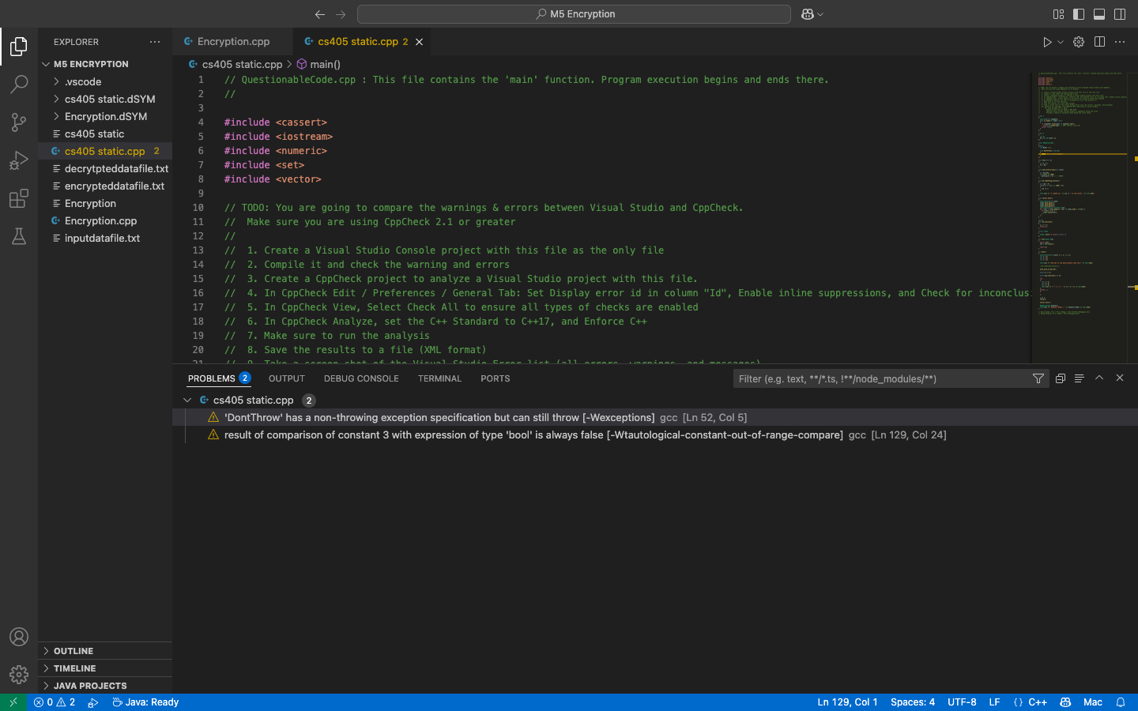
Vs code vs CPPcheck
I conducted a brief test between vs code and CPPcheck problem outputs, where vs code found 2 errors and CPPCheck found multiple with more information

Slide 10
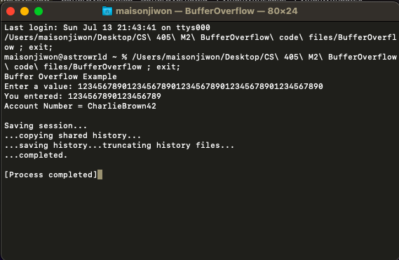
Buffer Overflow
I tested the ability to overflow an input value, which is mitigated by setting a limit of how many characters are allowed to be accepted

Slide 11
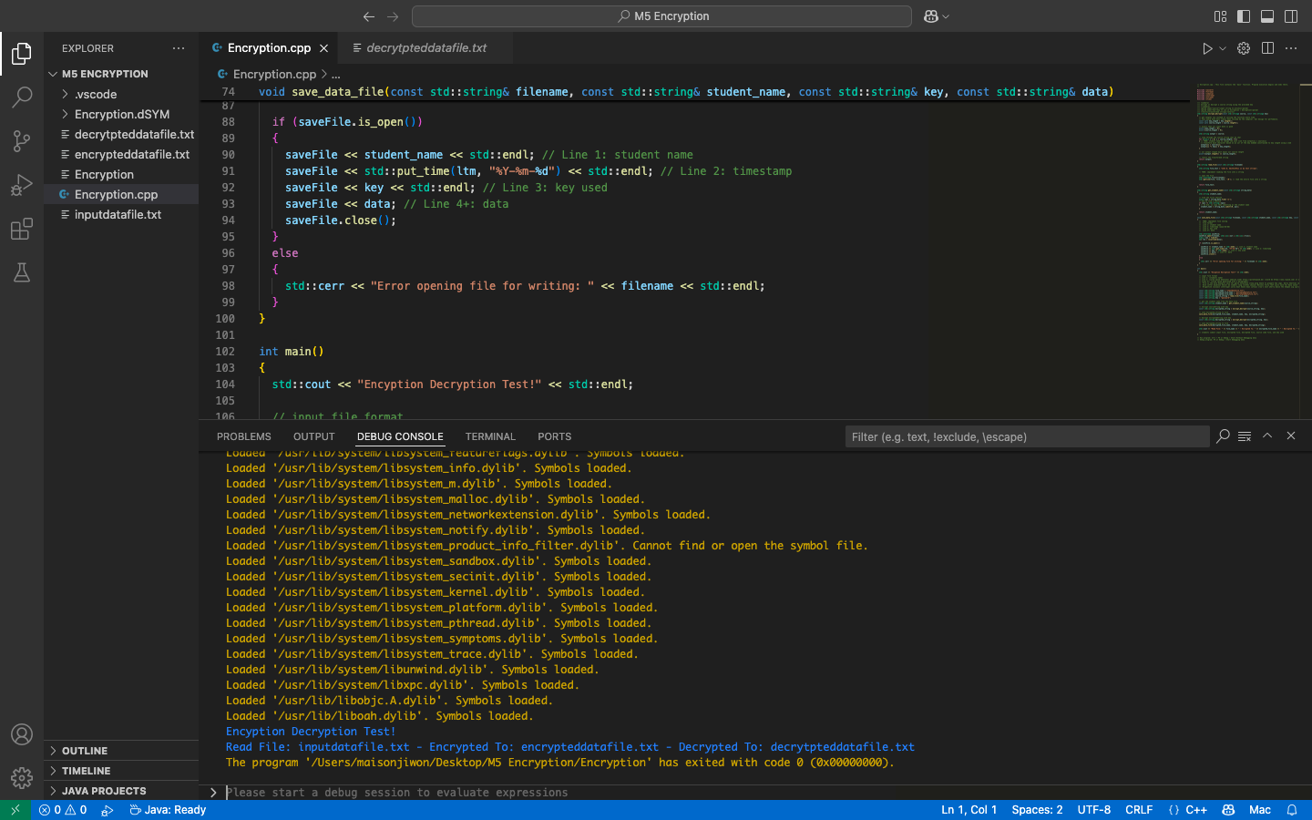
Encryption/decryption
I also tested the ability to decrypt a file and re-encrypt it. This adds another layer of security between the end user and the program itself.

Slide 12

AUTOMATION SUMMARY

Slide 13
TOOLS
DevSecOps is the continuous support and security enforcement from the start to the end of the software development lifecycle.
Tools used:
CPPCheck- static code analysis
G++- compiler
VS code- IDE

Slide 14
RISKS AND BENEFITS
Acting now instead of waiting for a problem to arise will mitigate damages and loss of data
This may cost more money upfront, but saves time and effort in the long run
Acting now will also create better trust between the shareholders and developers

Slide 15
RECOMMENDATIONS
Have continuous policy review and updates within the development team
Conduct white-hat testing to ensure no vulnerabilities are found
Abide by the defense in depth guidelines.

Slide 16
CONCLUSIONS
Adopt encryption, triple-A framework, and white-hat testing
Mind current cybersecurity threats and updates
Have an open line of communications between developers and testers

